Slide 1







A 2-days National Level Hackathon on
AI-powered Study Buddy & Mental Wellness Platform
StressSense – AI-powered Study Buddy
Team Name: Smart Scholars
Name of Leader: Shubham Garg
Team Member : Ronak Sharma, Rozi Chilwal, Shubham Garg
Date of submission : 5 September 2025
College Address : Rajasthan Technical University, Kota (Rajasthan)

Slide 2


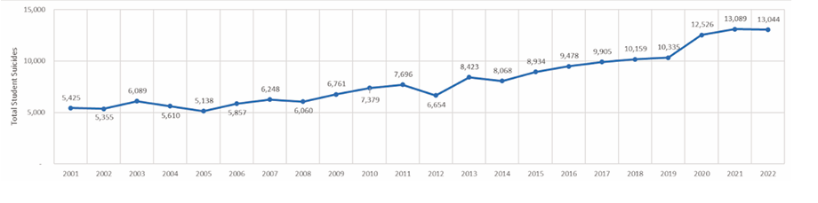
Problem Statement
Student suicides surpass population and overall suicidal patterns
Academic Stress Prevalence
86% of students report high academic stress in a survey of 570 Aspirants (PMC Study, 2024)
57.7% of those same students report low overall well-being
Student Suicides & Mental Health
Nearly 13,000 student suicides reported in India during 2021, with exam failure as a leading cause ( ThePrint, 2024 )
High Competition Pressure
NEET: 2.4 million aspirants
JEE: 1.4 million aspirants

Slide 3
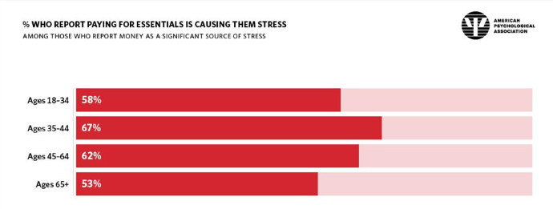
Projected Trends & Impact on Student Wellness
Projected Stress Surge
By 2028, over 90% of competitive-exam aspirants are expected to report high academic stress due to intensifying competition and digital overload.
Year-on-year stress levels have risen by approximately 4% since 2021.
Impact on Performance & Long-Term Well-Being
Burnout cuts study efficiency by up to 30%, leading to longer prep cycles and repeated attempts.
Coaching-program dropouts spike by 20% amid peak stress periods.
Chronic anxiety and depression rates among aspirants may climb by 15% without early intervention.

Slide 4
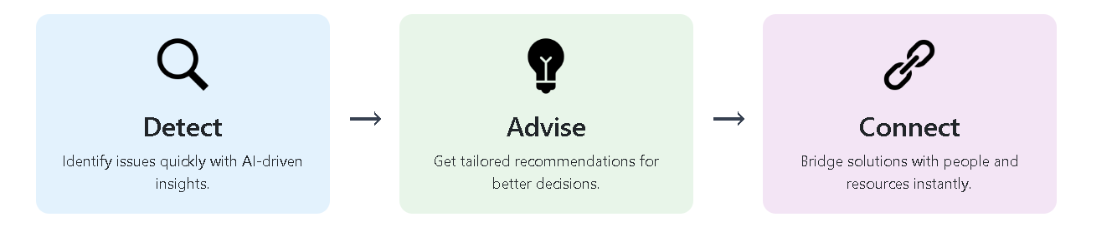
Proposed Solution (Overview & Uniqueness)
What We Do
StressSense is an AI-powered platform that detects, monitors, and reduces student stress levels throughout competitive-exam preparation.
Key Functions
Real-time stress and emotion detection via chat, voice, and survey inputs
Personalized tips including micro-break reminders, breathing exercises, and motivational nudges
On-demand booking of expert mentorship or counseling sessions
Unique Edge
Actionable Support: moves beyond mere prediction to deliver tailored coping strategies
Multimodal Interaction: supports text, voice, and survey inputs in both Hindi and English
Gamified Engagement: rewards, badges, and point-based incentives to encourage honest participation

Slide 5
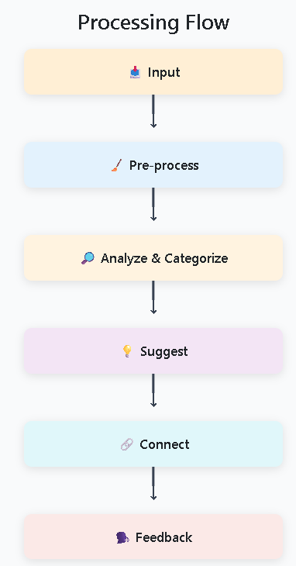
Approach & Methodology – Workflow
User Input
Students submit text chat messages, voice recordings, or quick surveys in Hindi or English.
Pre-processing
Text: noise removal, tokenization, translation (IndicTrans/Google Translate)
Voice: speech-to-text via Whisper, followed by language normalization.
AI Analysis
Stress detection using fine-tuned BERT/RoBERTa for text; emotion recognition from tone via Whisper embeddings.
Classification into stress categories (low, medium, high).
Personalized Output
Generate targeted suggestions: micro-break reminders, breathing exercises, motivational prompts.
Offer “Book Expert Session” for high-stress alerts.
Feedback Loop
Collect user feedback on suggestions.
Retrain models periodically to refine accuracy and cultural relevance.

Slide 6
Approach & Methodology – Challenges & Solutions
CHALLENGE | SOLUTION
Noise & Language Diversity | Spacy/NLTK Filtering; Indictrans And Google Translate For Vernacular Support
Model Accuracy & Bias | Fine-tune On Diverse Kaggle Dataset; Cross-validation; Periodic Bias Audits
User Engagement & Retention | Gamified Rewards, Peer Wellness Rooms, Reminder Notifications
Data Privacy & Compliance | End-to-end Encryption, Anonymized Logs For Retraining, GDPR/Indian Data Protection Adherence

Slide 7
Key Features (User-Centric)
Stress & performance tracking dashboard with visual heatmap and trend lines
🔹 📊 Analytics Dashboard / Heatmap icon (bar chart + heatmap)
AI “Process Buddy” chat interface delivering context-aware study and wellness tips
🔹 🤖 Chatbot / AI Assistant icon (chat bubble + robot face)
Voice-to-text input with real-time Hindi/English translation
🔹 🎤 Microphone + Translation/Globe icon (mic + “A→अ” style)
Peer collaboration & wellness rooms for group support and study sessions
🔹 👥 People/Group icon (two or more users with heart/support symbol)
Gamified rewards & badges to incentivize survey participation and wellness tasks
🔹 🏅 Medal/Badge icon (trophy, badge, or star)

Slide 8

Ethics, Privacy & Authentication
Data Privacy & Ethics
End-to-end encryption for all chat, voice, and survey data
Anonymized, aggregated logs used for model retraining
Compliance with GDPR and India’s Personal Data Protection Bill
Authentication & Access Control
OAuth2 / JWT-based secure login
Role-based access: Student, Mentor, Admin
Fine-grained IAM policies on AWS/GCP enforcing least-privilege

Slide 9
Tech Stack used
Frontend 🌐
React for web or Flutter for cross-platform mobile apps
Backend ⚙️
FastAPI (Python) or Node.js (JavaScript/TypeScript)
Database 🗄️
MongoDB with encryption at rest and in transit
AI / NLP 🤖
Hugging Face Transformers (BERT/RoBERTa) for text
Whisper for speech-to-text and emotion embeddings
spaCy / NLTK for pre-processing and tokenization
Cloud & DevOps ☁️
AWS or GCP infrastructure (EC2/Lambda, S3/Cloud Storage)
CI/CD pipelines, containerization (Docker, Kubernetes)
Monitoring & logging (CloudWatch / Stackdriver)

Slide 10
Data Collection & Privacy Measures
Data Collection & Privacy Measures
Data to Collect
User Profiles: age, gender, exam target, study schedule, consent status
Interaction Data: chat transcripts, voice recordings for emotion analysis, survey responses
Usage Metrics: session timestamps, feature engagement, session duration
Contextual Metadata: device type, language preference, optional location
Collection & Processing Workflow
Opt-in Onboarding: granular consent for each data category
Secure Transmission: TLS 1.3 encryption for all in-flight data
Pre-processing: pseudonymization of PII, noise filtering, translation normalization
Aggregation: remove direct identifiers before model training
Privacy & Security Safeguards
Encryption
AES-256 at rest
TLS 1.3 in transit
Access Control
OAuth2/JWT authentication
Role-based permissions (Student, Mentor, Admin)
Compliance
GDPR and India’s Personal Data Protection Bill
Regular security audits and penetration tests
User Rights
Data access, correction, and deletion on request
Privacy dashboard for consent management

Slide 11
Expected Outcomes & Evaluation Metrics
Expected Outcomes | Evaluation Metrics
Significant reduction in average stress scores (target: ≥25% drop over 4 weeks) Improved study focus and consistency (measured via longer active session durations) Early identification of high-risk students leading to timely expert interventions Creation of a positive, peer-supported study environment Scalability across multiple competitive exams (JEE, NEET, GATE, CAT, etc.) | Stress Reduction: percentage decrease in self-reported stress scores User Engagement: Daily Active Users (DAU), Weekly Active Users (WAU), average session length Model Performance: precision, recall, and F1-score for stress/emotion detection Expert Session Conversion: ratio of high-stress alerts resulting in booked sessions Retention & Satisfaction: week-over-week retention rate, Net Promoter Score (NPS) from wellness surveys

Slide 12
Future Scope
Gamified Wellness Ecosystem
Launch social study challenges, peer leaderboards, and community events
Reward badges and achievement tracking to sustain motivation
Global Expansion & Localization
Extend support to regional languages and exam formats (SAT, ACT, Gaokao)
Adapt cultural nuances and exam-specific workflows for broader adoption
Coaching & Ed-Tech Integration
Partner with coaching institutes to offer StressSense as a white-label LMS plugin
Provide APIs for real-time instructor dashboards and institutional analytics
Wearable Biometric Integration
Integrate heart-rate, galvanic skin response, and sleep-pattern data from smartwatches/fitness bands
Enhance stress detection with physiological signals for more accurate alerts
AI Counseling Chatbot
Deploy an empathetic virtual counselor leveraging CBT-inspired dialogue flows
Automatic escalation to human professionals when risk thresholds are met

Slide 13
Why This Project Stands Out
Data-Backed Insight
Built on large-scale surveys and national statistics, ensuring we tackle a validated, high-impact problem.
Actionable, Holistic Support
Moves beyond diagnosis to deliver personalized coping strategies alongside study tips.
Multimodal & Multilingual
Text, voice, and survey inputs in both Hindi and English for inclusive access.
Engagement-Driven Design
Gamified rewards, peer-support rooms, and expert sessions keep users motivated and honest.
Privacy-First & Scalable
End-to-end encryption, GDPR/PDPB compliance, and cloud-native architecture ready for national rollout.

Slide 14
Implementation Roadmap
Phase 1: Text-Based Prototype (Month 1–2)
Develop core chat interface and survey module
Integrate BERT/RoBERTa for stress detection on text inputs
Conduct internal alpha testing with 50 students
Phase 2: Voice & Survey Integration (Month 3–4)
Add Whisper-powered speech-to-text and emotion embeddings
Build quick-survey engine and reward-points logic
Pilot with 200 aspirants across two coaching centers
Phase 3: Expert Connect & Gamification (Month 5)
Enable booking workflow for mentors/counselors
Launch badge, leaderboard, and peer-room features
Run a 2-week beta with full feature set
Phase 4: Full-Scale Launch (Month 6)
Harden infrastructure (auto-scaling, CI/CD pipelines)
Roll out to multiple exam cohorts (JEE, NEET, GATE)
Implement feedback loop for continuous model retraining

Slide 15
Demo & Closing
Demo Plan
2–3 minute walkthrough video showcasing the full user journey:
User submits chat/voice/survey input
StressSense detects stress level and delivers personalized suggestions
User books an expert session directly from the platform
Rewards and feedback loop in action
Continuous Improvement
Live survey-based data collection to refine models and user experience
Real-time dashboard updates that adapt as more data flows in
Closing & Contact
Let’s make competitive-exam preparation healthier, safer, and smarter!
Team: Smart Scholars
Presented at: Samadhan 2.0 Hackathon
College: Rajasthan Technical University, Kota ( Rajasthan )
Contact: hello@stresssense.ai | linkedin.com/in/eng-shubham-garg
Thank you!

